Slide 1
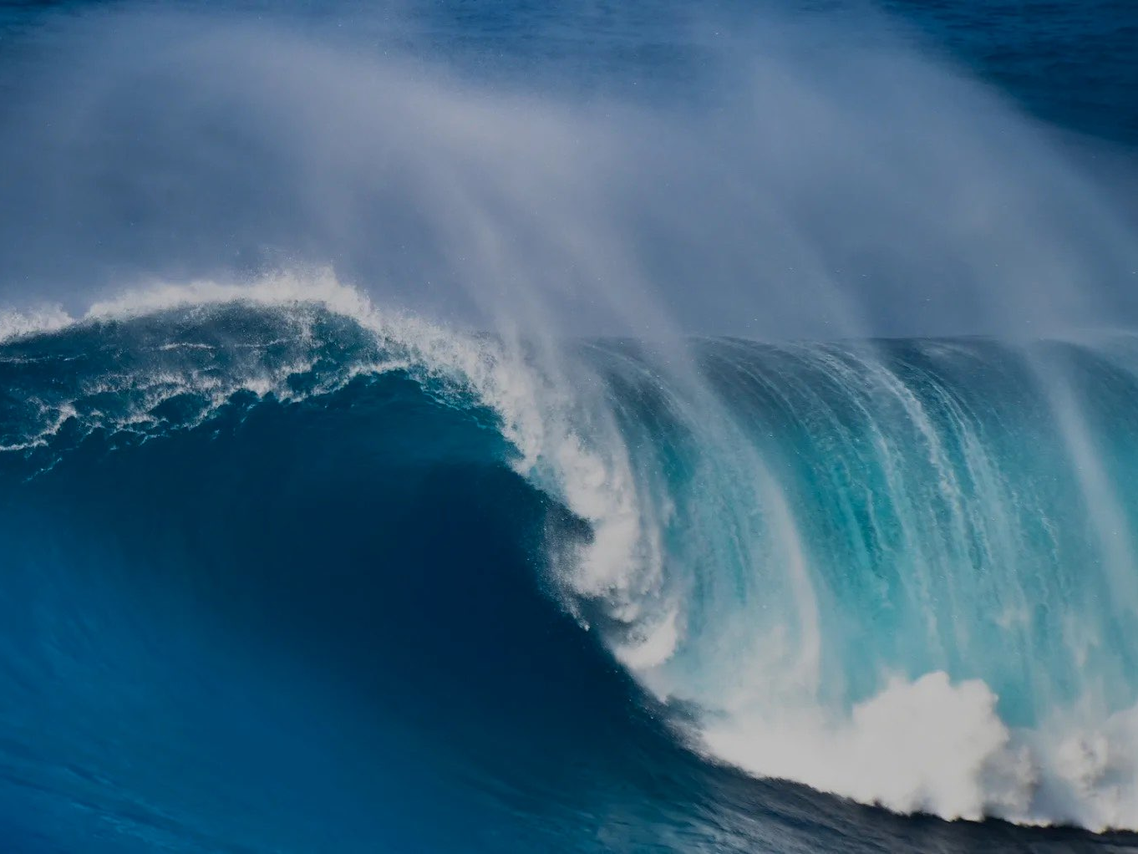
SwellSight
Your Smart Guide to Surf Conditions
eliya ZAKAY, Shalev ATSIS, sam SOTIL

Slide 2
Review and refine project definition
Motivation & Definition
Motivation: Surfers need accurate wave metrics from distant beach cams but rely on manual visual assessment
Problem: Manual assessment is time-consuming, inconsistent, and weather-dependent
Solution: AI system that analyzes beach cam footage to provide critical wave metrics
Dataset & Models
Depth-Anything-V2 for high-frequency wave texture capture
FLUX.1-dev + ControlNet for physics-accurate synthetic waves
DINOv2 backbone for geometric wave understanding
Data: Beach cam images (RGB + Depth), synthetic labeled dataset through generation pipeline.
Metrics: MAE/RMSE for height, Accuracy/F1 for classifications.

Slide 3
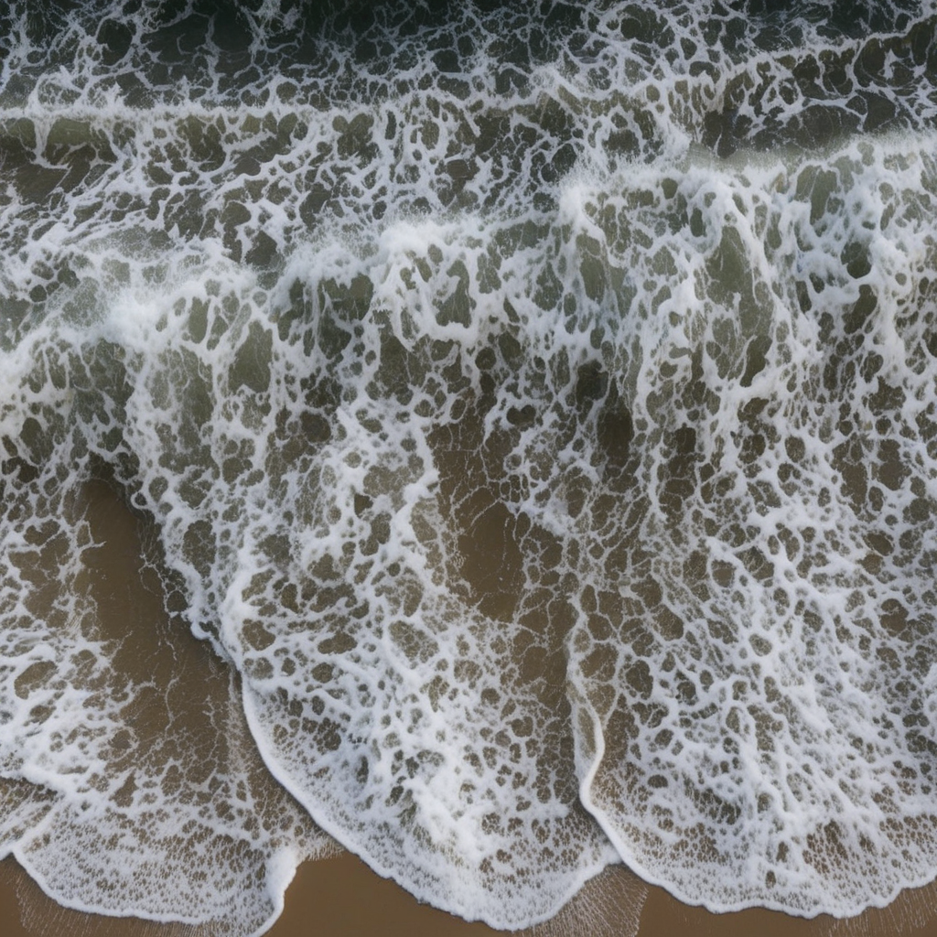
Key Achievements
Generated via our Synthetic Pipeline
End-to-end AI pipeline from raw beach cam footage to actionable wave metrics.
Real-time processing capability (<2000ms per image).
Solved manual labeling challenge through synthetic data generation.

Slide 4

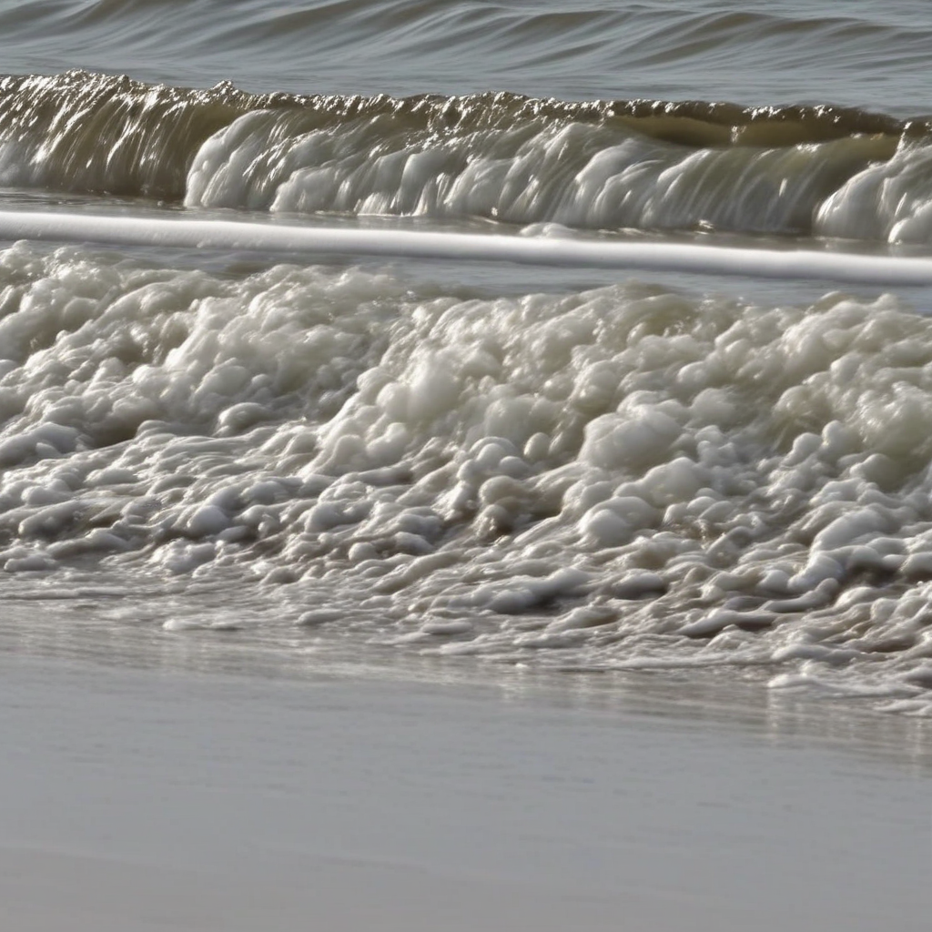
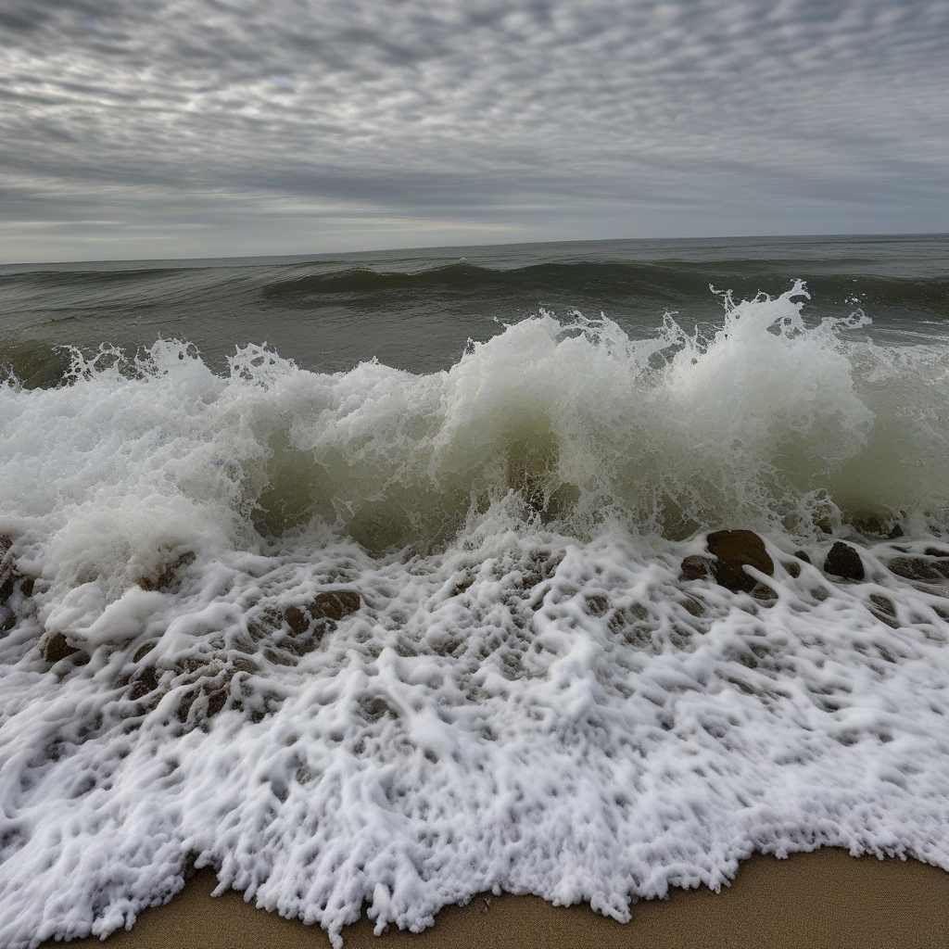

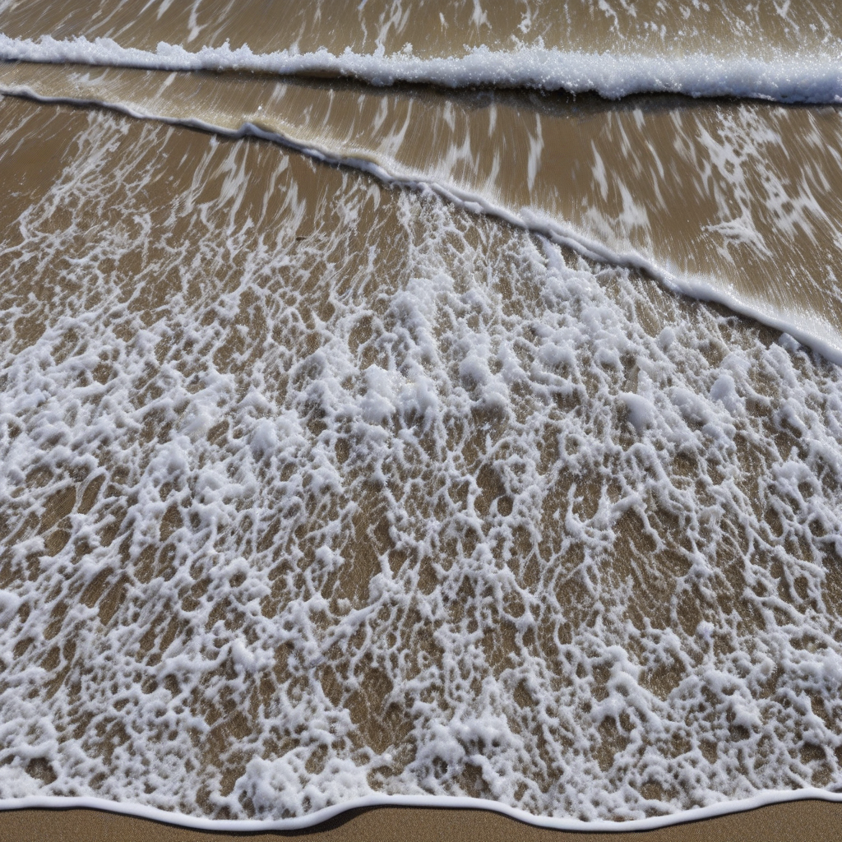

Slide 5
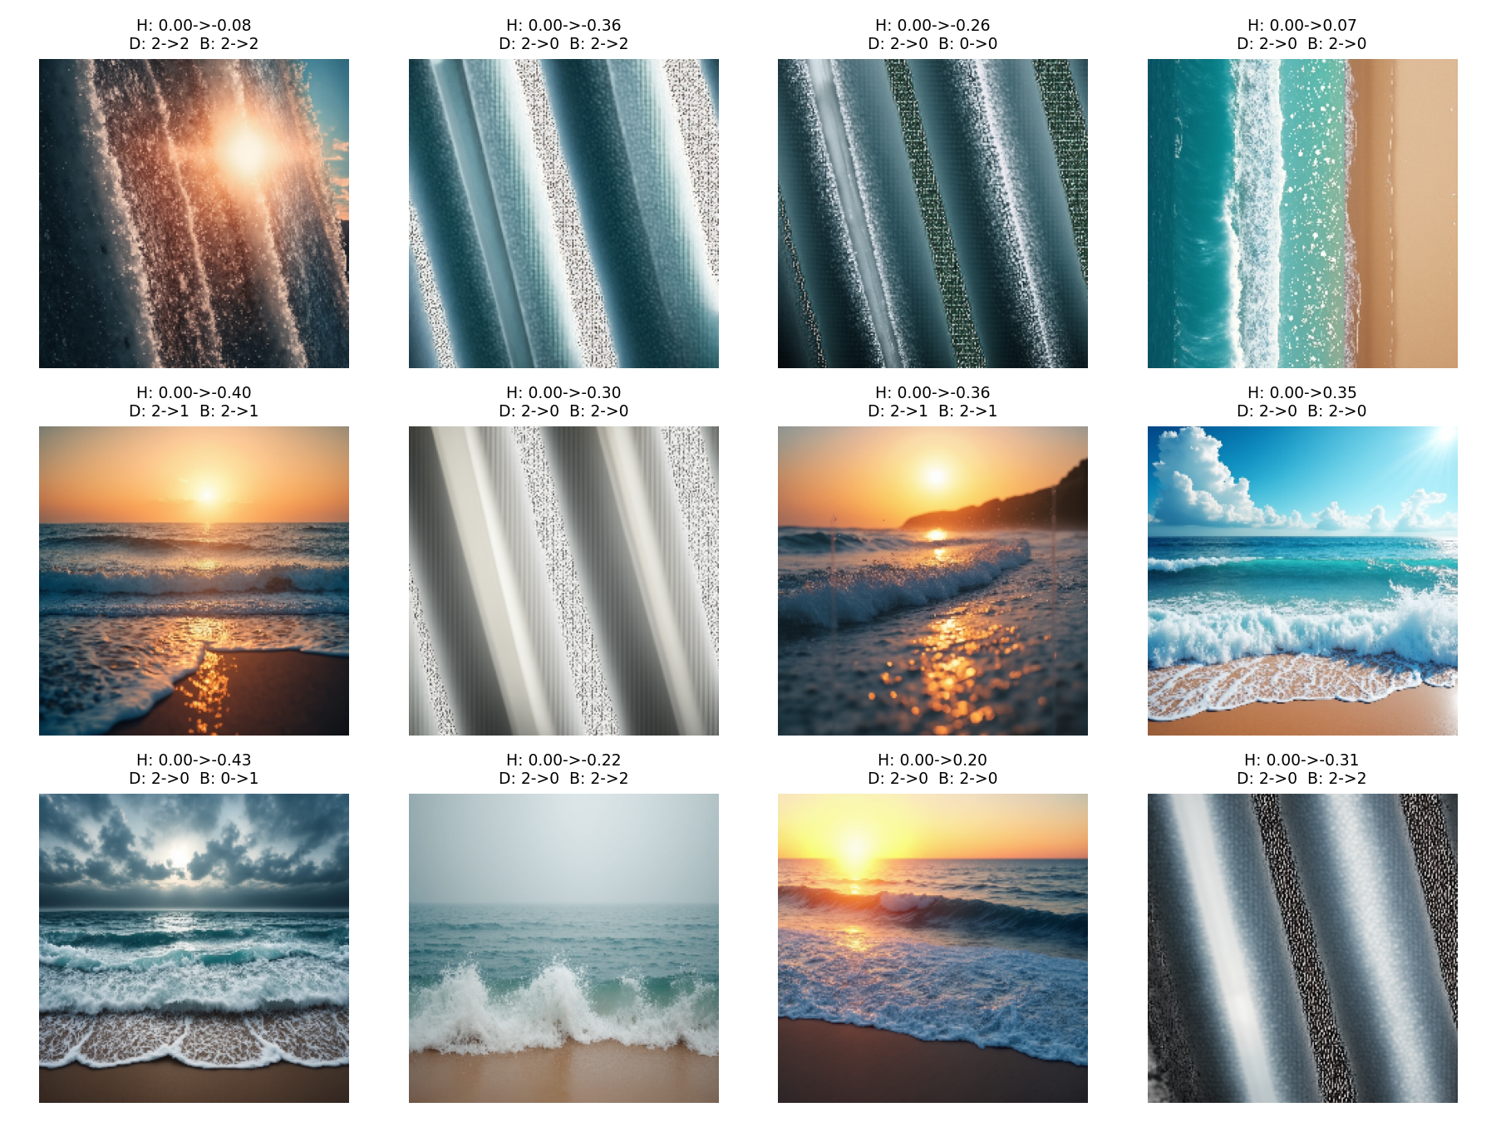
Synthetic Examples Generated During Our Work

Slide 6
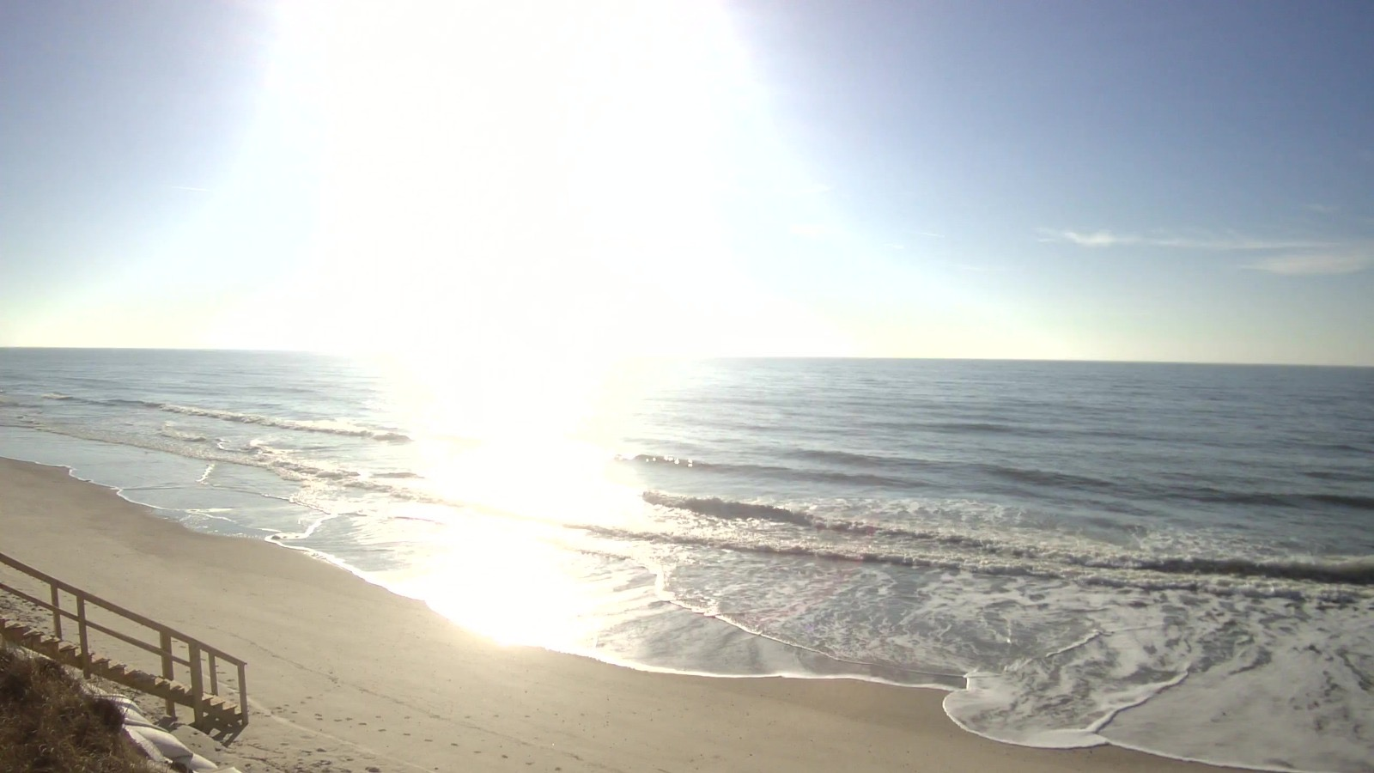
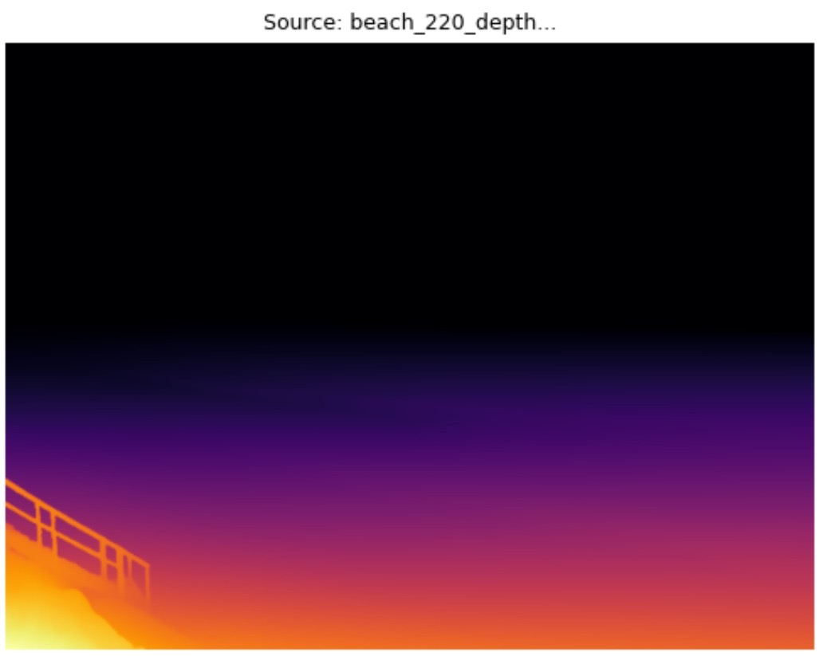
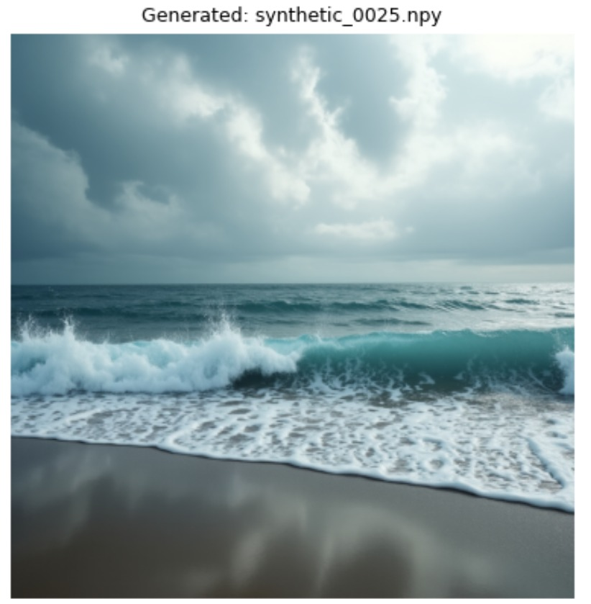
The original photo

Slide 7
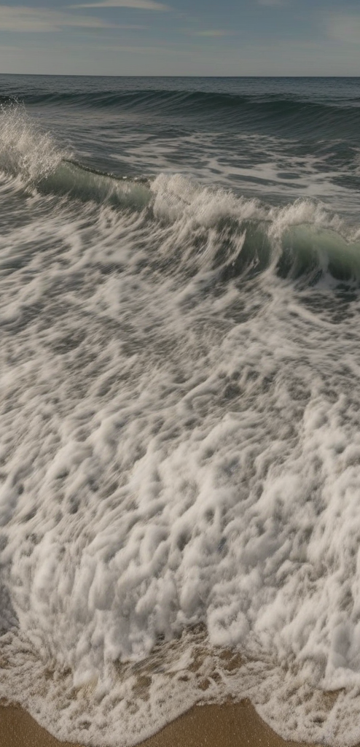
Novel Contributions
Hybrid Pipeline Architecture: Generative AI trains Analytical AI (sim-to-real approach).
Advanced Depth Sensing: Depth-Anything-V2 for high-frequency wave texture capture.
Physics-Accurate Synthesis: FLUX.1-dev + ControlNet for photorealistic wave generation.
Geometric Intelligence: DINOv2 self-supervised backbone for superior wave understanding.
Multi-Task Learning: Single model predicting three metrics simultaneously with shared representations.

Slide 8
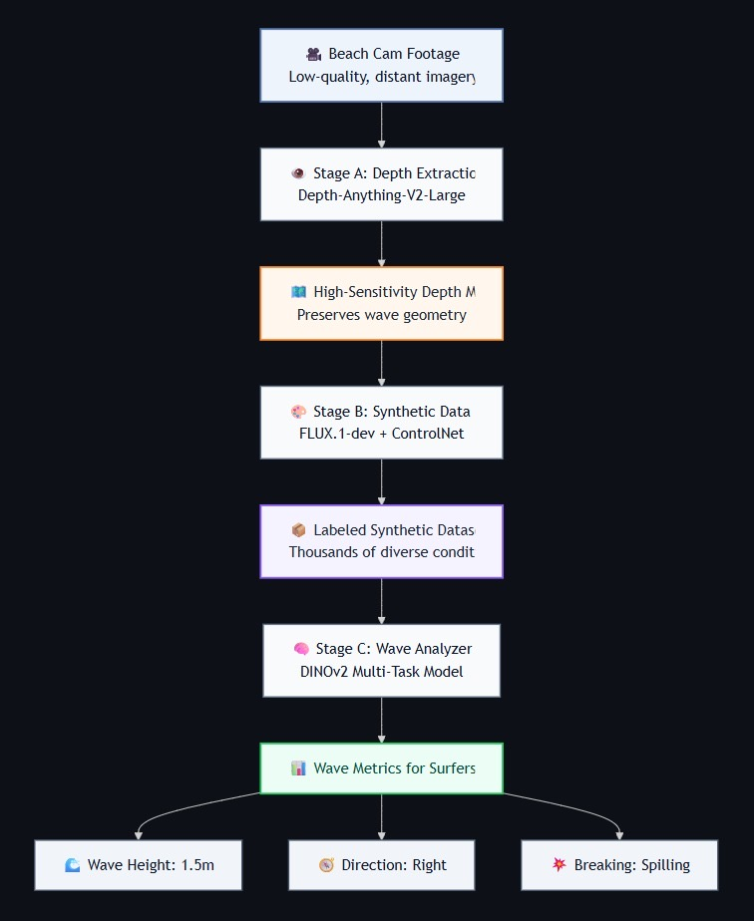
Data Generation
Pipeline and Models Used

Slide 9

Review methodology- Three Stage Pipeline
Stage A: Depth Extraction (The "Eye")
Model: Depth-Anything-V2-Large (518×518 resolution)
Extracts high-sensitivity depth maps preserving wave texture and distant shapes
Output: Normalized grayscale depth maps
Stage B: Synthetic Data Factory (The "Simulator")
Model: FLUX.1-dev + Shakker-Labs ControlNet-Depth
Generates 500+ photorealistic synthetic images with perfect labels
Creates diverse weather/lighting conditions while preserving wave geometry
Stage C: Wave Analyzer (The "Brain")
Backbone: DINOv2-ViT-B/14 (frozen, 768-dim features)
Input: 4-channel (RGB + Depth) beach cam images
Architecture: Multi-task model with three specialized prediction heads
Training: Sim-to-real strategy (50 epochs pre-training + 150 epochs fine-tuning)

Slide 10
Review methodology
Quality Efforts:
Multi-level validation (image, depth, generation quality)
Confidence calibration (isotonic/Platt/temperature scaling)
Data augmentation preserving scale (critical for height measurement)

Slide 11
Efforts and Challenges
Problem Faced:
Using MiDaS model produced low precision depth maps.
Solution provided:
Implemented Depth-Anything-V2 model to ensure better precision and small details sensitivity.
Problem Faced:
Synthetic images generated have low quality and unlogical details
Solution provided:
Implemented FLUX.1-dev + Shakker-Labs ControlNet-Depth to improve data generation.

Slide 12
Results – Model Evaluation
Task | Metric | Value | Interpretation
Wave Height | MAE | 0.181m | Precise; strong predictive performance.
Wave Height | RMSE | 0.218m | Dependable; few large errors.
Wave Type | Accuracy | 42.0% | Weak; barely beats chance.
Wave Type | Macro F1 | 0.276 | Poor class-wise balance.
Direction | Accuracy | 4.0% | Critically broken; likely bug.
Direction | Macro F1 | 0.026 | Complete model failure.
Performance Insights
Wave height regression is highly effective, achieving a precise mean absolute error of just 18 centimeters.
Direction prediction is broken with near-zero accuracy, confirming a critical mismatch between labels and predictions.
Breaking type classification remains weak, struggling to capture the fine textural details required for accurate distinction.

Slide 13
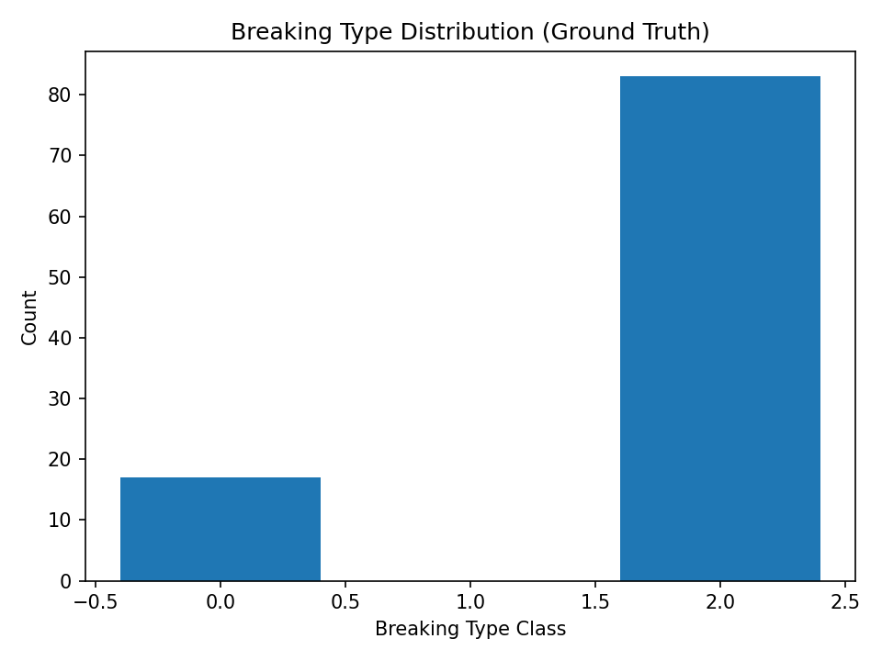
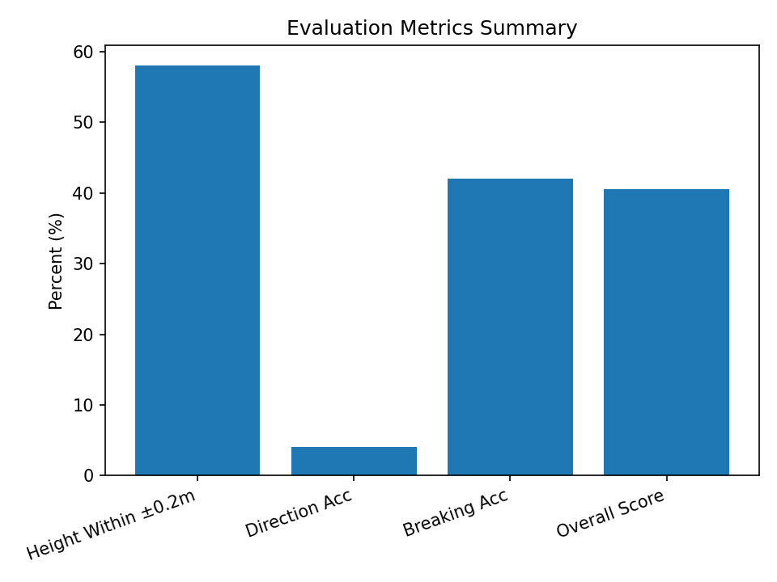
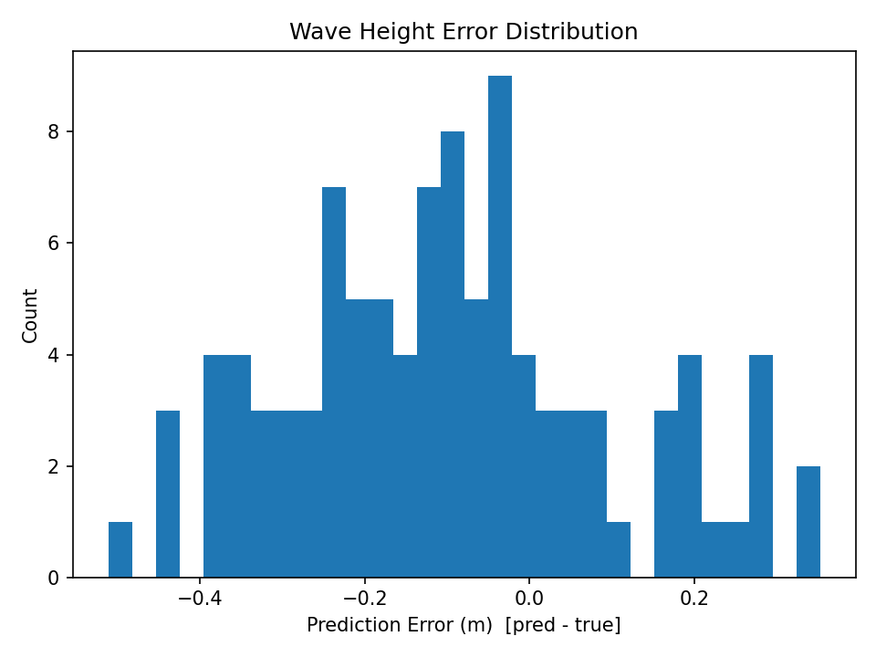
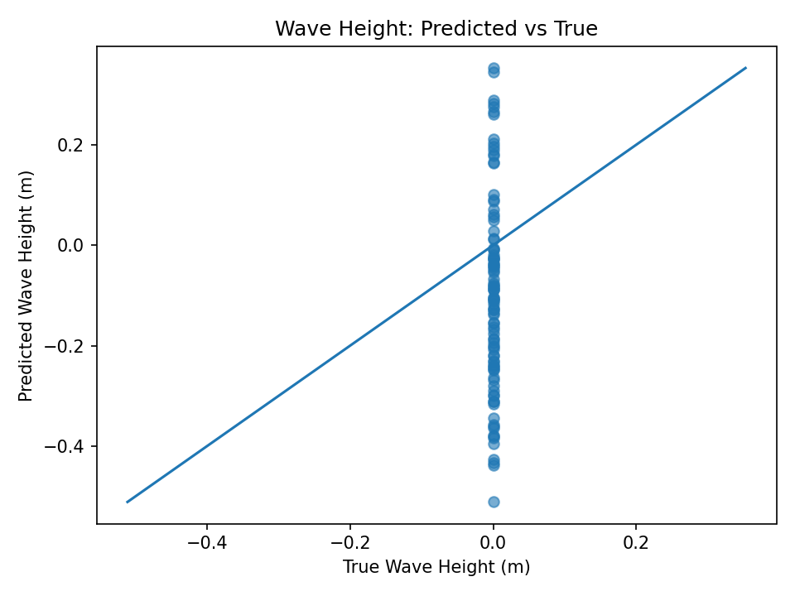

Slide 14
Conclusion
Measuring Results
Yes. Delivered a functional, multi-task system capable of height estimation and wave classification.
Successfully completed e2e pipeline of data processing, generation, augmentation, and model training.
Learnings & Future Work
Limitation: The real dataset (729 images) is sufficient for a Proof-of-Concept but too small for broad global generalization.
Plan & Research: It is crucial to preform deep research of the best model available for each necessary task, along with organized plan and architecture of the model.
Future Experiment 1 (Video): Move from single-frame to temporal analysis (video) to capture wave period and dynamics.
Future Experiment 2 (Deployment): Optimize the model (ONNX/TensorRT) for mobile deployment to allow surfers to analyze waves directly from the beach.

